Slide 1
Trichuris trichiura

Slide 2
Trichuris trichiura, commonly known as the whipworm, is a parasitic nematode that infects the human gastrointestinal tract, primarily the cecum and ascending colon1
The name "whipworm" comes from its distinctive shape, which resembles a whip .
with a long, slender anterior (front) part and a thicker posterior (rear) part.
The habitat of Trichuris trichiura (whipworm) primarily includes the human gastrointestinal tract. They reside mainly in the cecum and the large intestine.
Outside the human host, the eggs of T. trichiura can be found in soil, especially in areas with poor sanitation where human feces contaminate the environment. The eggs need moist soil to mature and become infective.

Slide 3
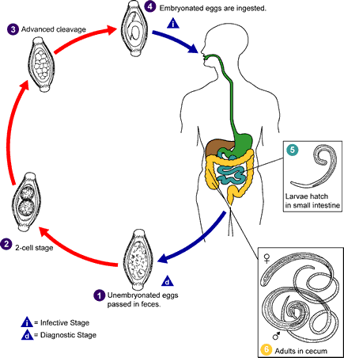
Trichuris trichiura
Life cycle

Slide 4
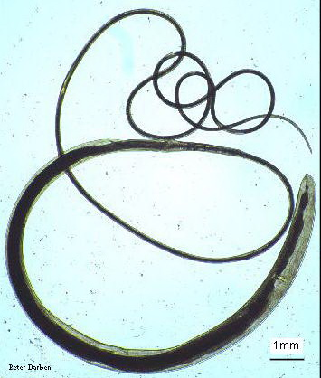
Trichuris trichiura:
A-Female:
whip-like body
with thin anterior 2/3body
thick posterior 1/3 body.
bead-like cells surrounding intestinal tract in the anterior end, called stichocytes.

Slide 5
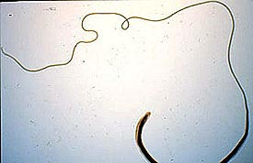

Slide 6
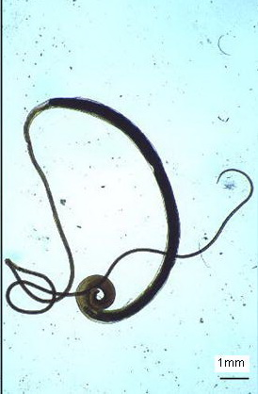
B-Male:
body same as in female.
posterior end strongly curved with
one spicule.

Slide 7
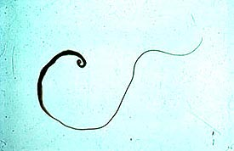

Slide 8
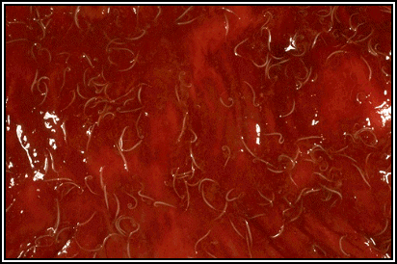
Trichuris trichiura in the large intestine. Many worms are present, each with its anterior end embedded in the intestinal mucosa, resulting in the erythema.
Notes:
http://www.biosci.ohio-state.edu/~parasite/trichuris.html
Erythema /eri’thi:ma/ 红斑

Slide 9
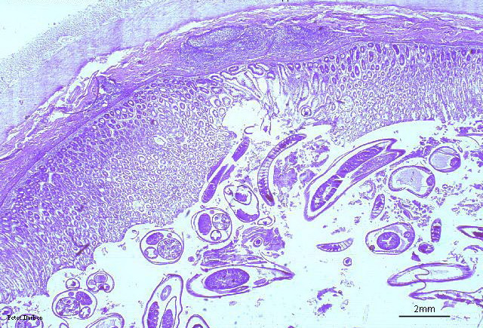
c. section in mucosa:
small round section in anterior part of worm,
in columnar epithelial cells of mucosa.
larger rounded sections in posterior part of worm, in lumen of intestine.

Slide 10
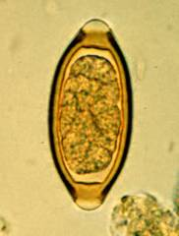
D-Eggs:
Barrel-shaped or
lemon-shaped eggs
With lateral plug like
thickining.
Egg single-celled,
unembryonated.

Slide 11
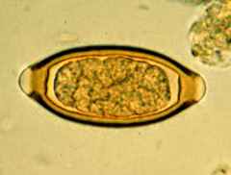
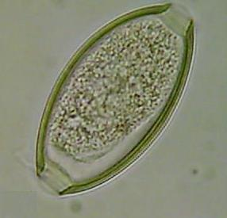
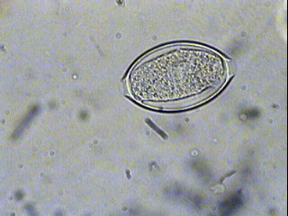
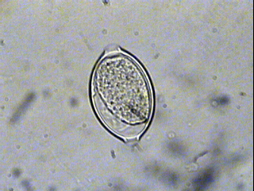
Plug
Plug
In Iodine s.
In saline s.
Trichuris trichiura Egg 50 X 25 µm
Note : the egg barrel – shaped, with two polar plugs yellowish brown in colour
( bile – stained ) has a double shell, the outer one is bile – stained

